Slide 1
Travel Route Planner using GA and solving TSP
Group 12
2019145081 Taejun Kang
2020147049 Hyundong Kim

Slide 2

Contents
Contribution of the Source Paper
Limitation of the Source Paper
Extension
Data
Code
Result Comparison
Conclusion & Future Work
Reference
Appendix(Code)

Slide 3
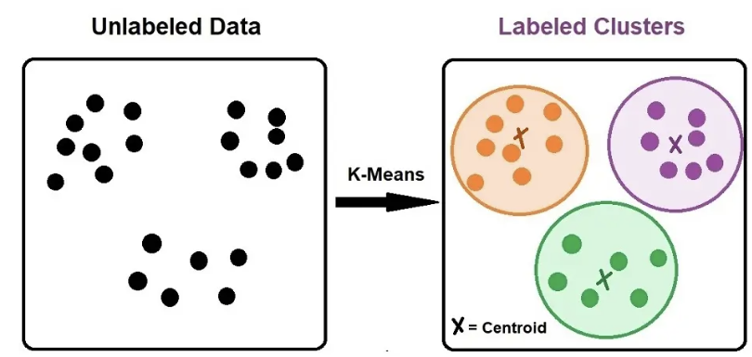
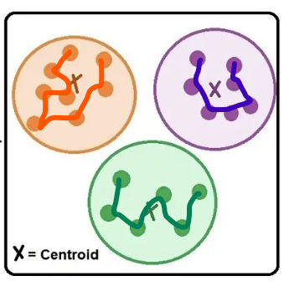
Contribution of the Source Paper
A Development of Travel Itinerary Planning Application using Traveling Salesman Problem and K-Means Clustering Approach. - Rani, S., Kholidah, K. N., & Huda, S. N.
Algorithm for making travel itinerary using TSP and k-means clustering technique is proposed.
Travel Routes
TSP
https://www.ejable.com/tech-corner/ai-machine-learning-and-deep-learning/k-means-clustering/

Slide 4
Limitation of the Source Paper
Clusters are formed based only on the points’ distance.
Without considering the size of clusters
Some cluster may contain too many points for daily travel.
Day 1
Day 2
https://www.ejable.com/tech-corner/ai-machine-learning-and-deep-learning/k-means-clustering/

Slide 5
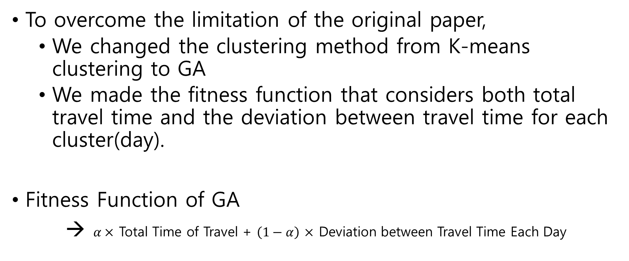
Extension
To overcome the limitation of the original paper,
We changed the clustering method from K-means clustering to GA
We made the fitness function that considers both total travel time and the deviation between travel time for each cluster(day).
Fitness Function of GA
→ $α×$ Total Time of Travel + $\left(1−α\right)$ $×$ Deviation between Travel Time Each Day

Slide 6
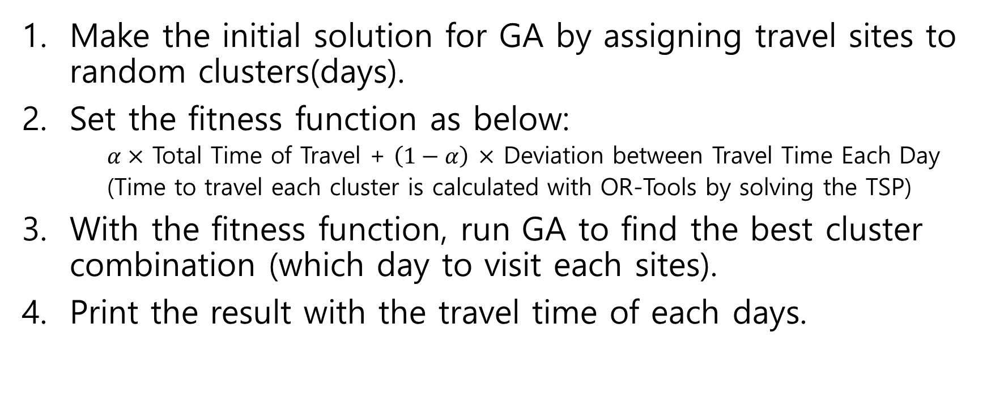
Methodology
Make the initial solution for GA by assigning travel sites to random clusters(days).
Set the fitness function as below:
$α×$ Total Time of Travel + $\left(1−α\right)$ $×$ Deviation between Travel Time Each Day
(Time to travel each cluster is calculated with OR-Tools by solving the TSP)
With the fitness function, run GA to find the best cluster combination (which day to visit each sites).
Print the result with the travel time of each days.

Slide 7
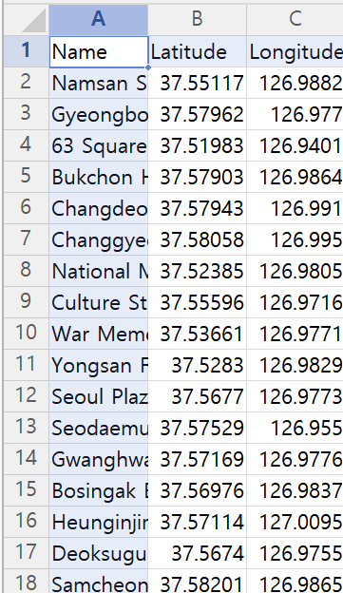
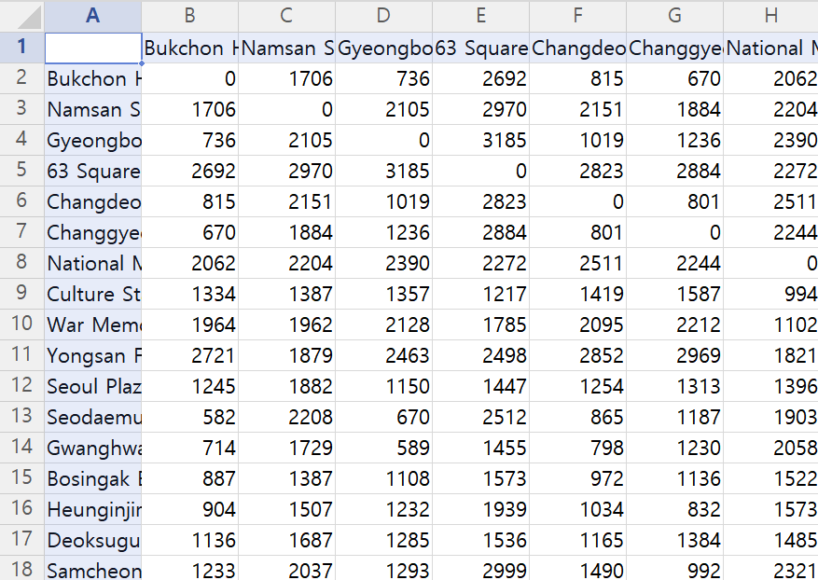
Data
Longitude and Latitude of 34 Tourist Attractions (via Google Map)
Time Duration by Public Transportation between 34 Tourist Attractions (via Google Map)
List of Attractions
'Bukchon Hanok Village', 'Namsan Seoul Tower', 'Gyeongbokgung Palace', '63 Square', 'Changdeokgung Palace', 'Changgyeonggung Palace', 'National Museum of Korea', 'Culture Station Seoul 284', 'War Memorial of Korea', 'Yongsan Family Park', 'Seoul Plaza', 'Seodaemun Prison History Museum', 'Gwanghwamun Square', 'Bosingak Belfry', 'Heunginjimun Gate', 'Deoksugung Palace', 'Samcheong-dong Alley', 'Bangi-dong Baekje Tombs', 'Myeongdong Cathedral', 'Hwangudan Altar', 'The Blue House', 'National Assembly Building', 'National Library of Korea', 'Bukak Skyway Octagonal Pavilion', 'Banpo Bridge Night View', 'Lotte World Tower', 'Sungnyemun Gate', 'Seoullo 7017', 'Deoksugung Stonewall Walkway', 'Dongdaemun Design Plaza (DDP)', 'Starfield Library', 'Namdaemun Market Tourist Information Center', 'Ikseon-dong Hanok Street'

Slide 8
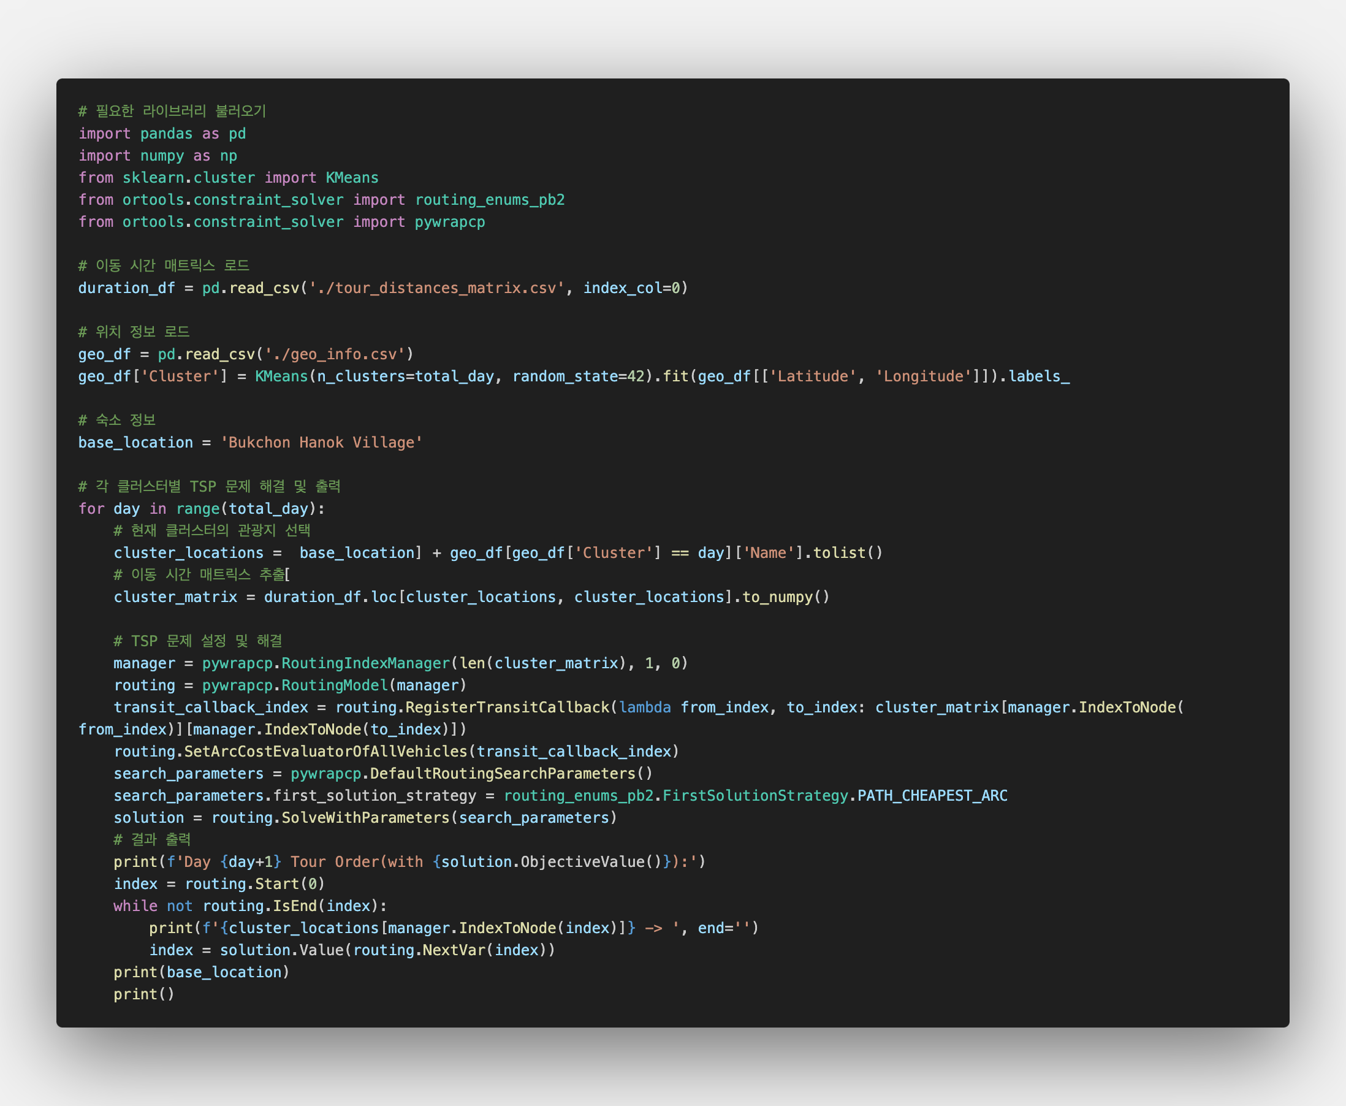
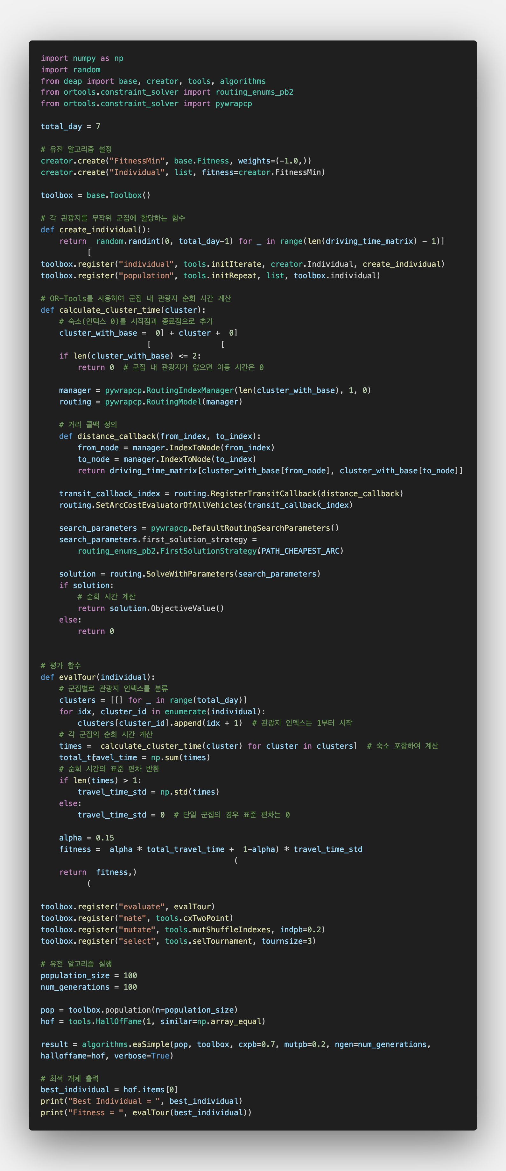
Code
Source Paper
Suggestion

Slide 9
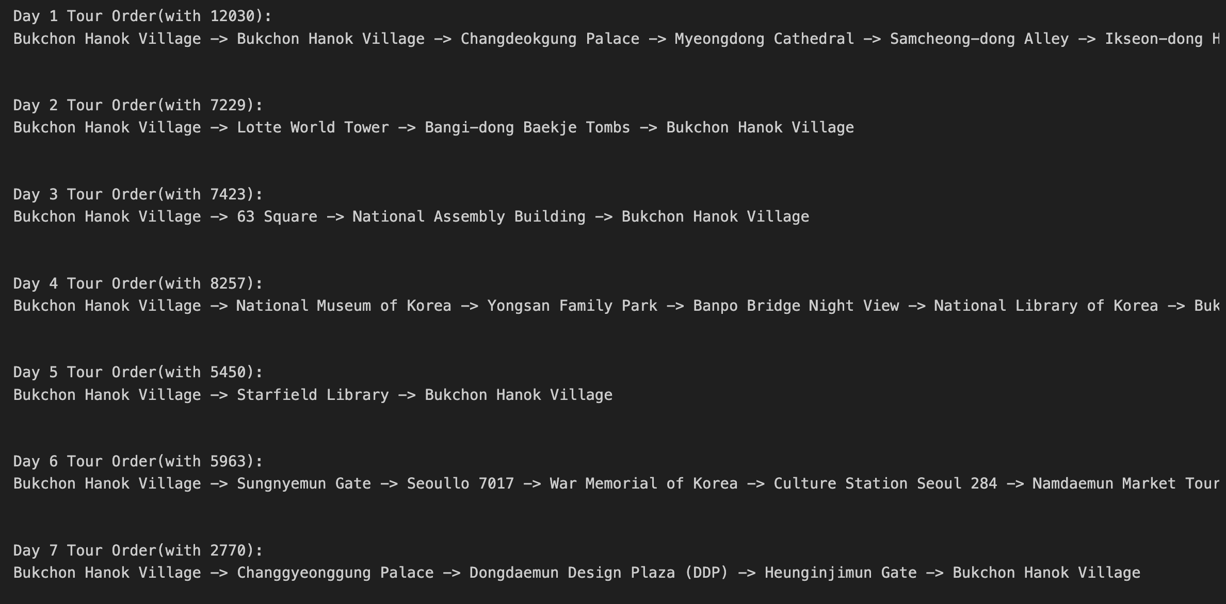
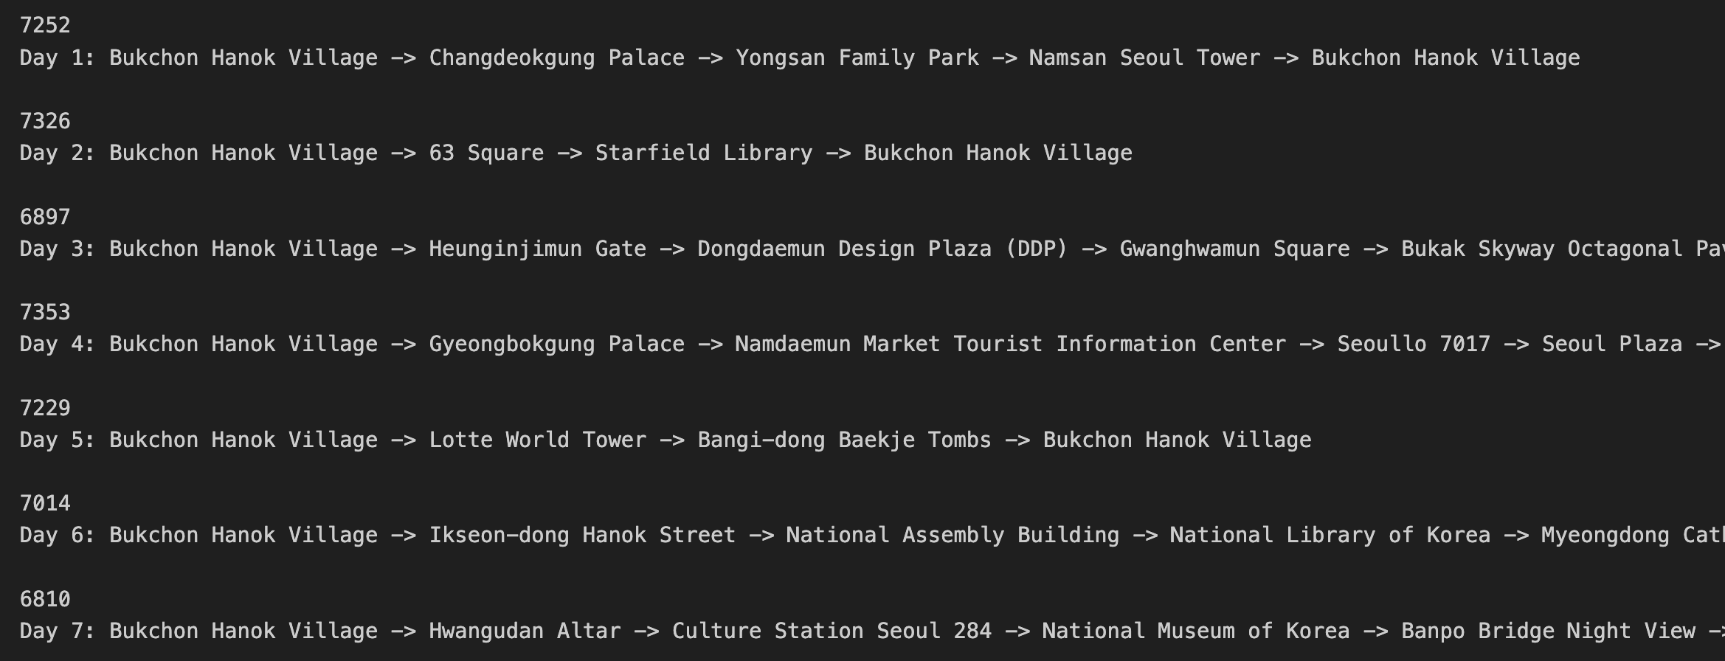
Result Comparison
Source Paper (K-Means)
Suggestion (GA)
Best Individual = [0, 3, 1, 0, 3, 6, 6, 6, 0, 3, 3, 2, 3, 2, 3, 3, 4, 5, 6, 2, 5, 5, 2, 6, 4, 6, 3, 3, 2, 1, 3, 5]
K-means only considers physical coordinates (not the real traveling time), and doesn’t consider the size of clusters
It results to high fluctuation between days.
Day 7 has 46 minutes(3 sites)
Day 1 has 5 hours(15 sites) for travel time only
Too little time for sight-seeing
Using GA and real public transportation data, it results in practical travel time
with reasonable cluster sizes
It results to low fluctuation between days.
Day 7 has 1hour 53min(6 sites)
Day 4 has 2hour 2min(10 sites) for travel time
→ Enough time for sight-seeing

Slide 10
Conclusion
We found out that clustering using GA gave better tour plan than the source paper.
As we used GA for clustering the sites, as the problem grows, we might have to consider how to tune the hyper parameters.
Future Work
This methodology only considered transportation time to move between sites. In the future work, we can add sight-seeing time in the consideration.
Now, we only create clusters to match the total travel days (# of clusters = total travel days). In the future work, we can make more detailed clusters (can move without using public transportations) and make more specific plan of the travel.

Slide 11
Reference
Rani, S., Kholidah, K. N., & Huda, S. N. (2018). A Development of Travel Itinerary Planning Application using Traveling Salesman Problem and K-Means Clustering Approach. In Proceedings of the 2018 7th International Conference on Software and Computer Applications (ICSCA '18) (pp. 327–331). https://doi.org/10.1145/3185089.3185142
https://data.seoul.go.kr/dataList/OA-21050/S/1/datasetView.do
https://www.google.co.kr/maps/?hl=ko
https://developers.google.com/optimization?hl=ko

Slide 12
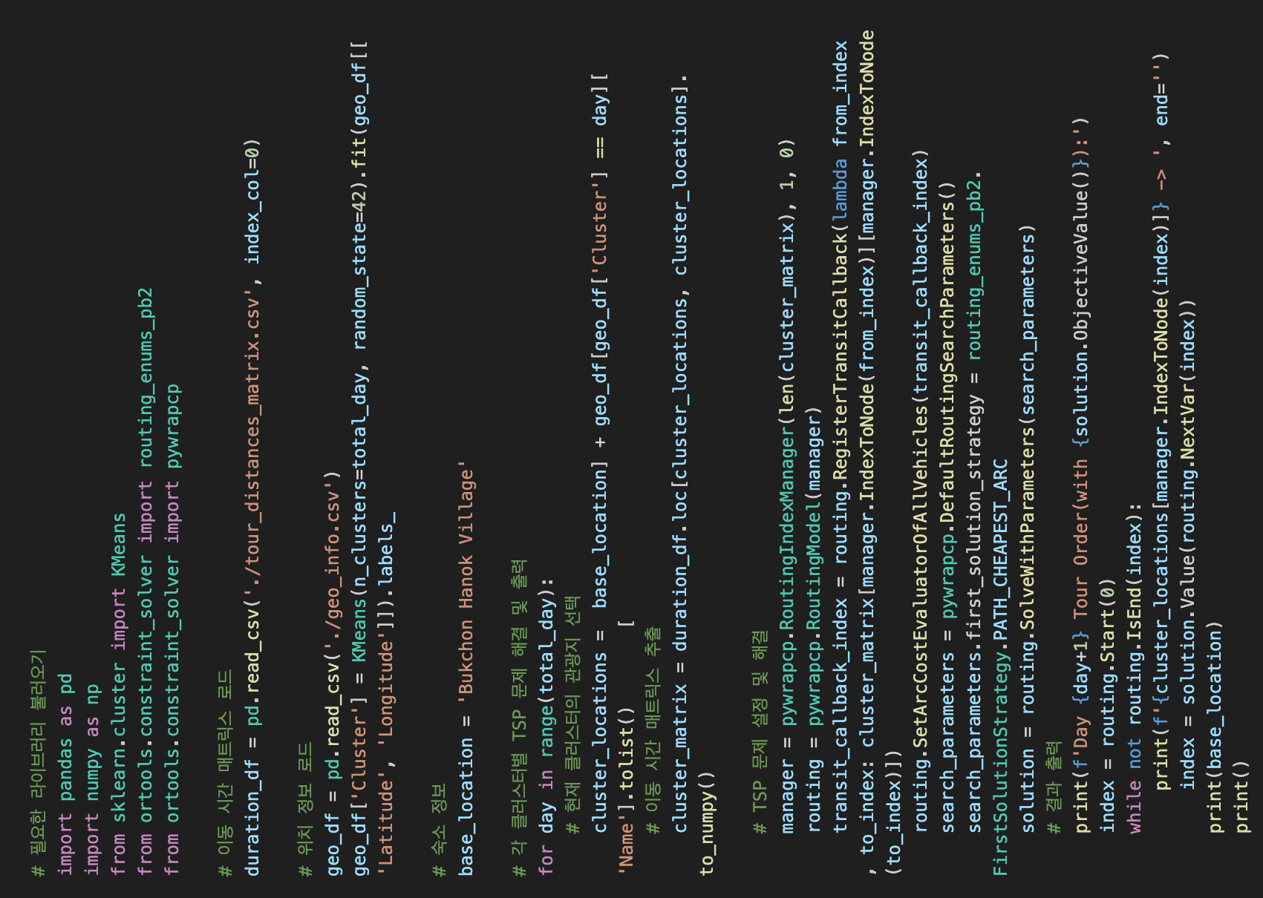
Appendix 1 – Original paper code

Slide 13
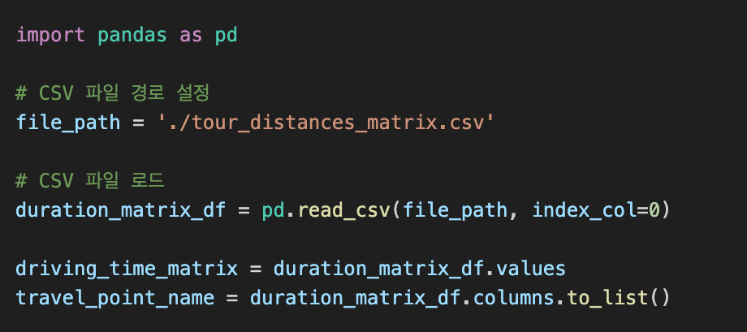
Appendix 2 – Proposed code

Slide 14
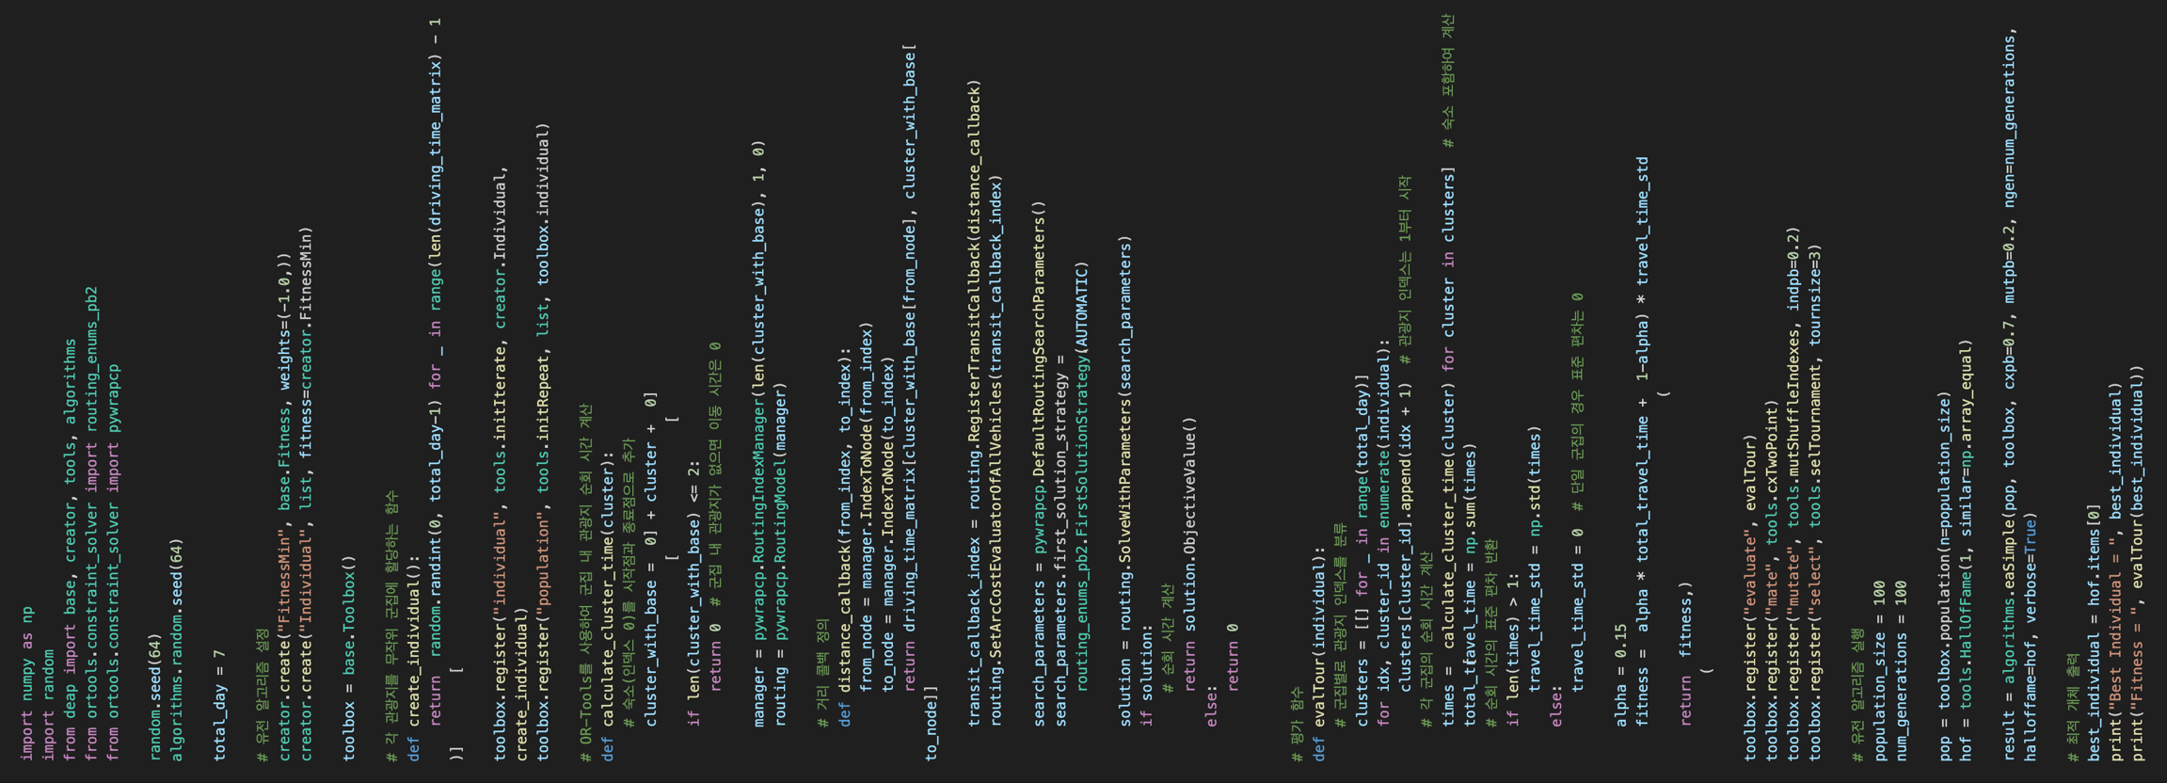
Appendix 2 – Proposed code

Slide 15
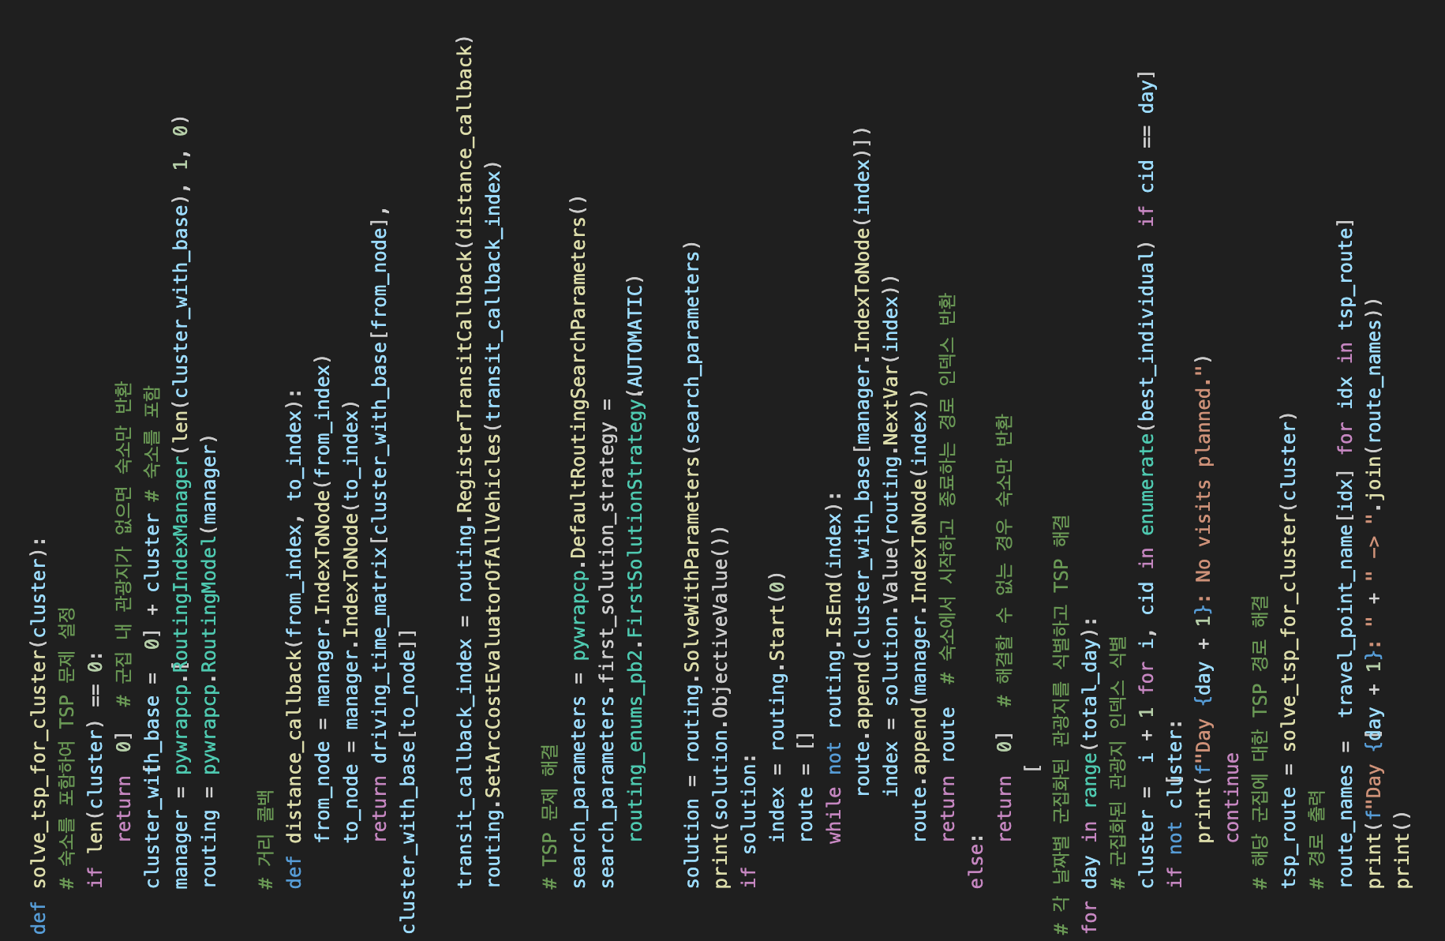
Appendix 2 – Proposed code

